Slide 1

Strategic Human Resources Management
UNIT 2

Slide 2

Nature of SHRM
Long-term Focus
Associated with Goal-Setting
Interrelated with Business Strategies
Fosters Corporate Excellence Skills

Slide 3


Aims of SHRM
To develop Strategic Competencies
To give Sense of Direction
To achieve Integration
To formulate Business Strategy

Slide 4

SHRM Concern
Home Country Employees
Host Country Employees
Third Country Employees

Slide 5

PERSPECTIVES ON STRATEGIC HRM
The Universalistic Perspective
The Contingency Perspective
The Configurational Perspective

Slide 6

STRATEGIC FIT
A situation that occurs when a specific project, target company, or product is seen as appropriate with respect to an organization’s overall objectives.

Slide 7

FACTORS TO CONSIDER WHEN LOOKING AT STRATEGIC FIT
Management team
Customer relationships
Corporate mission
Align the organizational structure, objectives, and administrative arrangements

Slide 8

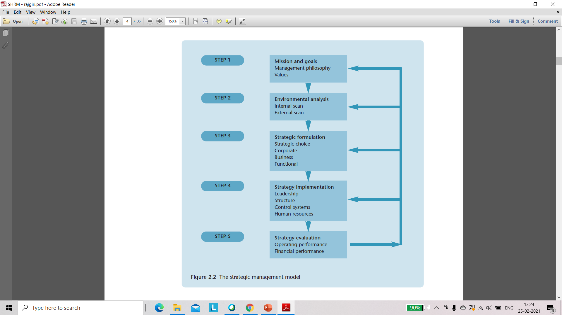
Model of Strategic Management

Slide 9
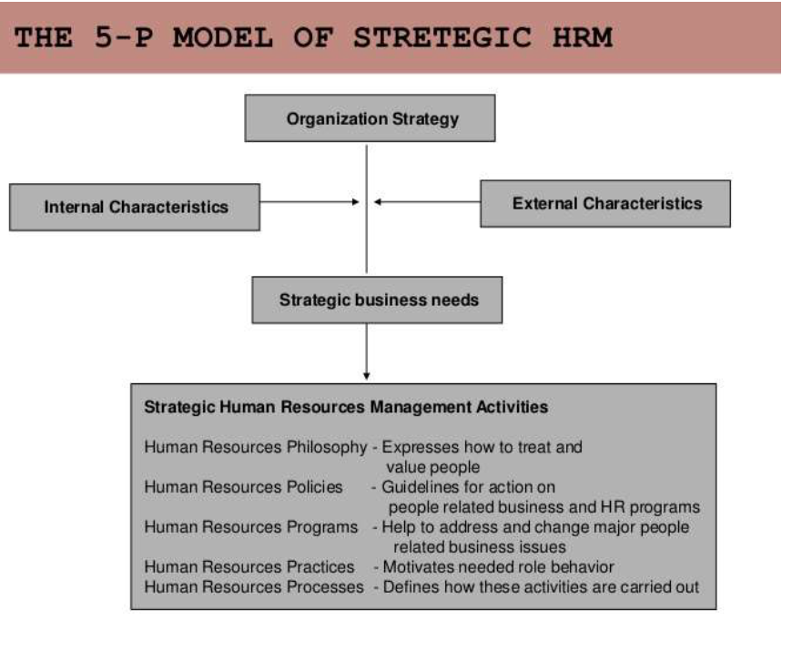

Slide 10

Importance of SHRM
a) Helps firm in achieving cost-effective engagement of Labour
b) Enables firm to meet changing needs
c) Provides clear-cut goals, direction, and future focus
d) Helps Organization in Planning and Executing Organizational Changes
e) Ensures Optimum Utilization of Organizational Resources
f) Develops, Manages and Sustains Skills and Knowledge

Slide 11

Challenges of SHRM
i. Absence of Long-term orientation
ii. Lack of Strategic Reasoning
iii. Lack of adequate support from top management
iv. Resistance from Labour Unions
v. Fear of Failure
vi. Rigidity of HR Practices

Slide 12
Difference between Traditional HR and Strategic HR

Slide 13
Difference between Traditional HR and Strategic HR

Slide 14

Strategic staffing is a kind of staffing strategy wherein an organization creates a sustainable plan to address any staffing concerns (now and in the future).
Strategic staffing refers to a strategy of hiring smaller core numbers of permanent employees and using temporary employees for other, more specialized position.

Slide 15

Benefits of Strategic Staffing
Maximizes staff utilization
More systematic way to address HR concerns
Prepare for future staffing problems

Slide 16

Steps in Strategic Staffing
Identification
Recruiting
Development
Retention

Slide 17

Internal Recruiting
Internal job posting.
Nomination by manager.
Knowledge, skills and abilities database.
Succession planning.

Slide 18

STAFF RETAINING AND MOTIVATING TECHNIQUES
Seek buy-in
Encourage contributions
Recognize employees
Nip negativity in the bud
Keep employees informed.

Slide 19
Cont..,
Help fulfill career goals
Maintain workforce satisfaction
Provide training
Give constant feedback
Communicate often

